Slide 1
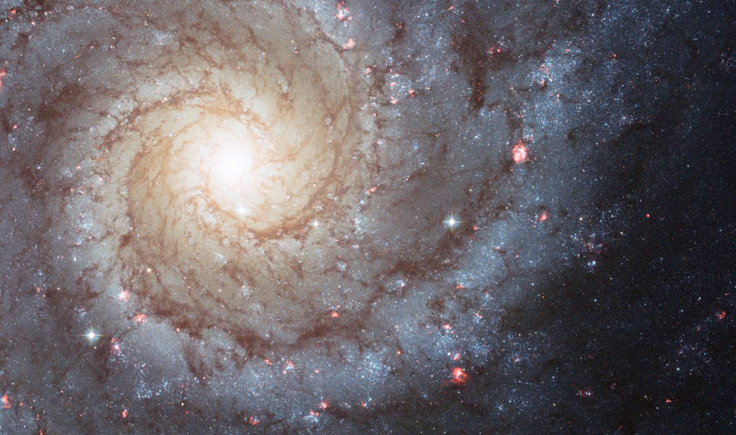
Improving galaxy morphologies for sdss with deep learning
sÁnchez et al. 2018
Presented by brett bonine
Astr 5900 machine learning
Fall 2020

Slide 2
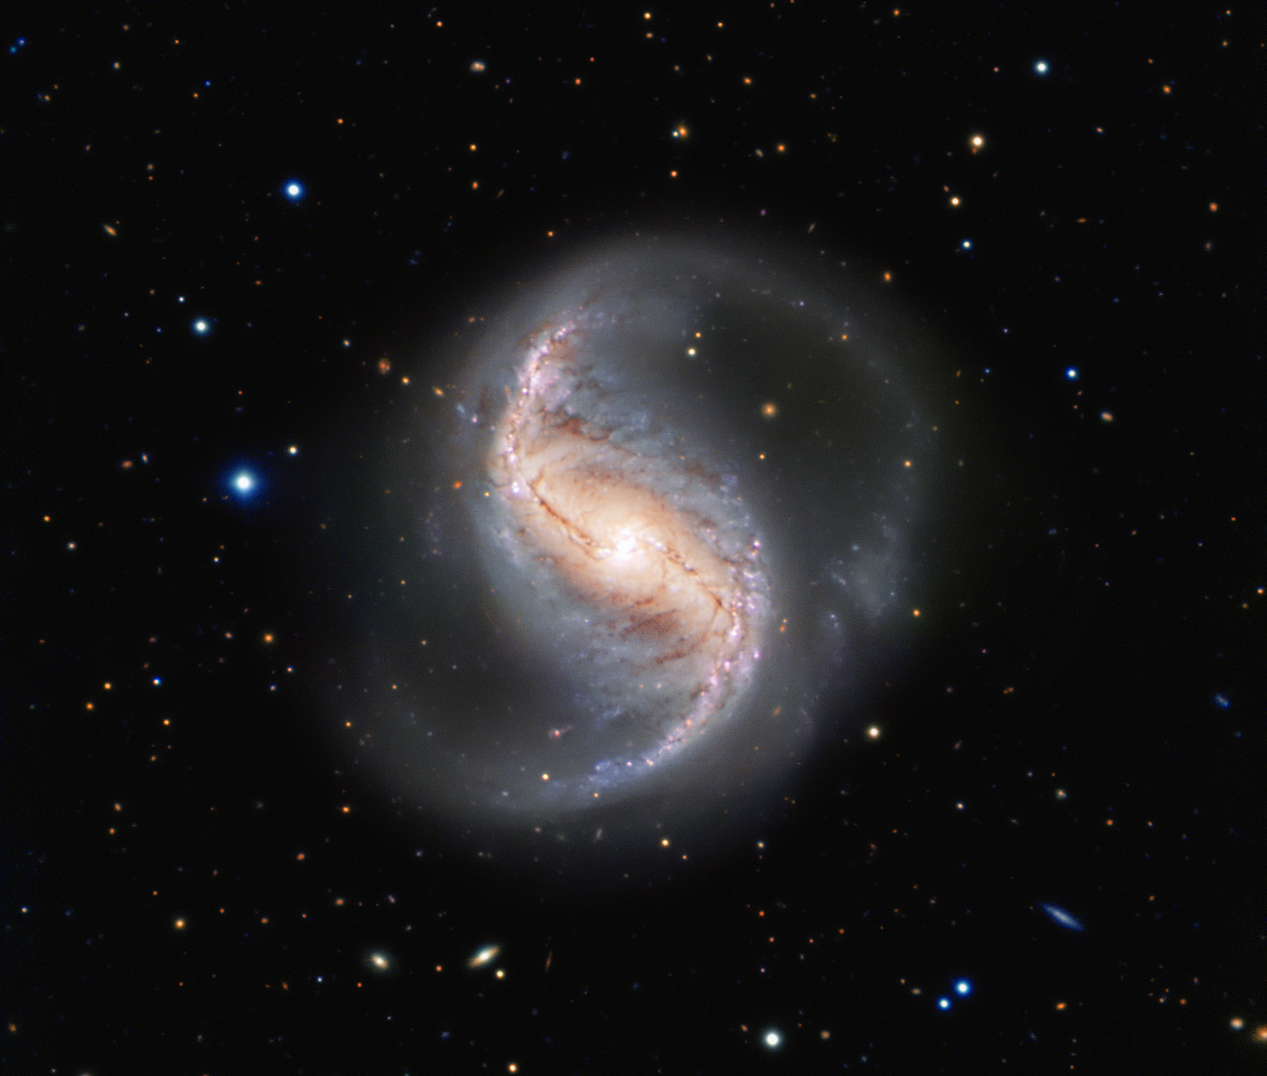
OUTLINe
Background: Galaxy Morphology
Training Sets
Network Architecture
Results
GZ2
D10
Conclusion

Slide 3
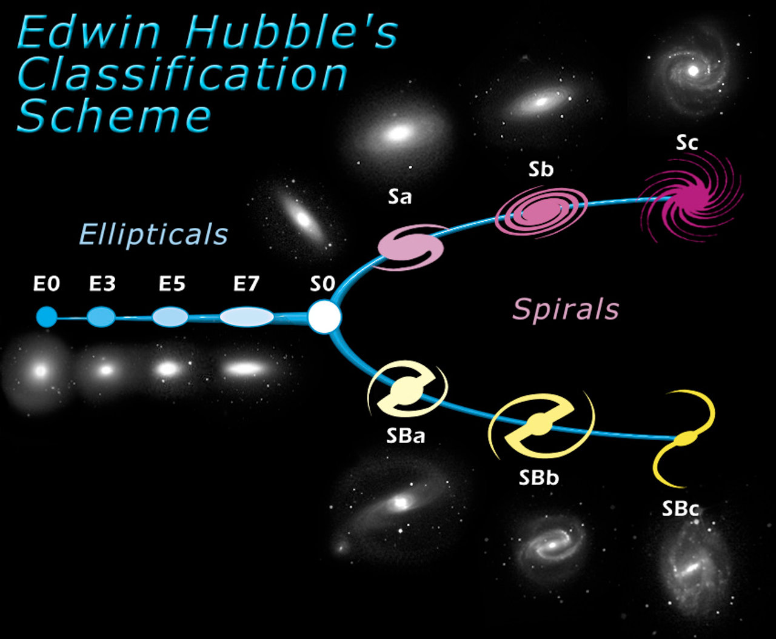
Background: Galaxy Morphology
Edwin Hubble:
Classified galaxies by ‘evolutionary’* stage.
*(but not really)
Ellipticals: ‘Early’ Type
Spirals: ‘Late’ Type
de Vaucouleurs:
Assigned each galaxy in the Hubble sequence a specific number T
Related to by ratio of bulge to disk mass
T < 0: Early Type
T = 0: Lenticular
T > 0: Late Type
How do you classify large numbers of galaxies?

Slide 4
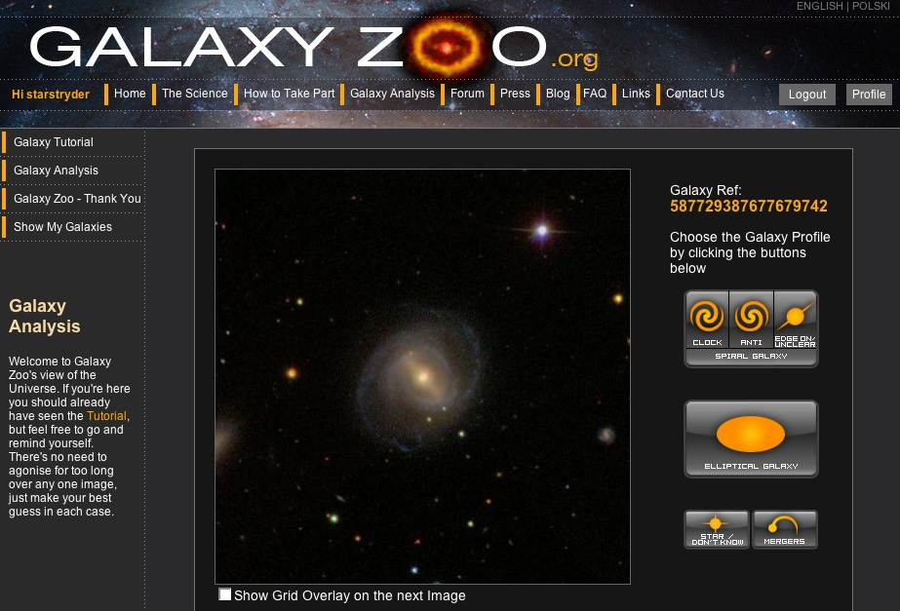
Galaxy zoo
Outsource your work to unpaid citizen scientists!
Galaxy Zoo 2: Catalog of 240,000 SDSS galaxies classified by volunteers
Tree based: Basic questions about morphology that lead to different follow-up questions based of response
GZ2: Per galaxy, 11 total classification tasks with 37 possible responses
’
Sounds useful as a training set for neural nets!

Slide 5
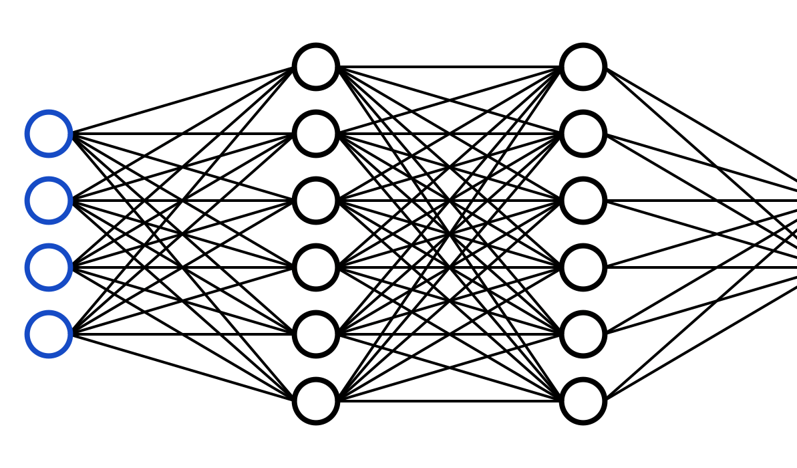
Neural nets for automated classification
Huertas-Company et al. (2015)
Dieleman et al. (2015)
Problems with previous studies:
Entire GZ2 catalogue used in training set, including galaxies with uncertain classifications
Users of GZ2 under-identify bar structures
Difficulty discerning between S0 and E galaxies
How to improve this?

Slide 6
sÁnchez et al. 2018
Train GZ2 features independently in binary mode instead of solving regression problem
Train a separate catalog of 14,034 galaxies hand classified by a professional astronomer (N10)
Better identification of bar structure
Used to train model to identify T type in regression

Slide 7
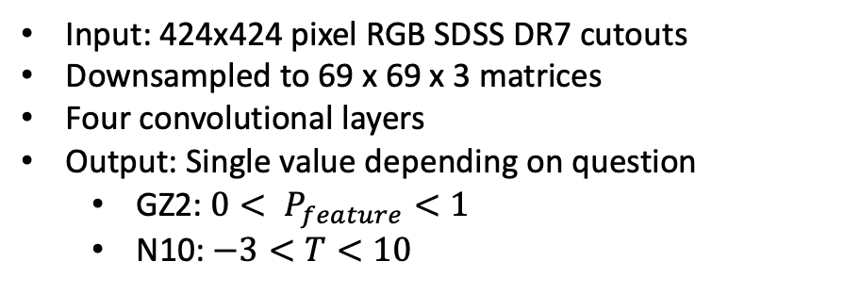
Network architecture
Input: 424x424 pixel RGB SDSS DR7 cutouts
Downsampled to 69 x 69 x 3 matrices
Four convolutional layers
Output: Single value depending on question
GZ2: $0< P_{feature}<1$
N10: $−3<T<10$
50 training epochs
Batch size: 30
Learning rate: 0.001
Augmented training data to reduce over-fitting:
Images zoomed, flipped, and offset in each epoch

Slide 8
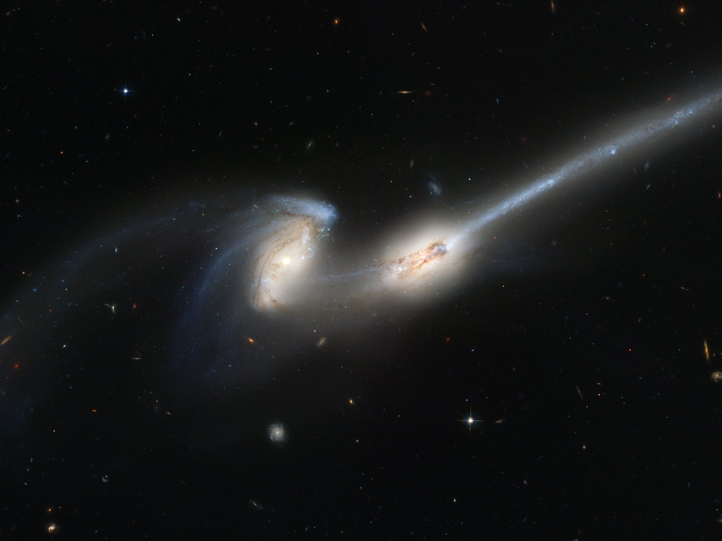
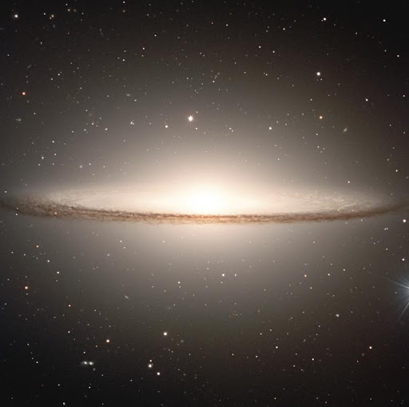
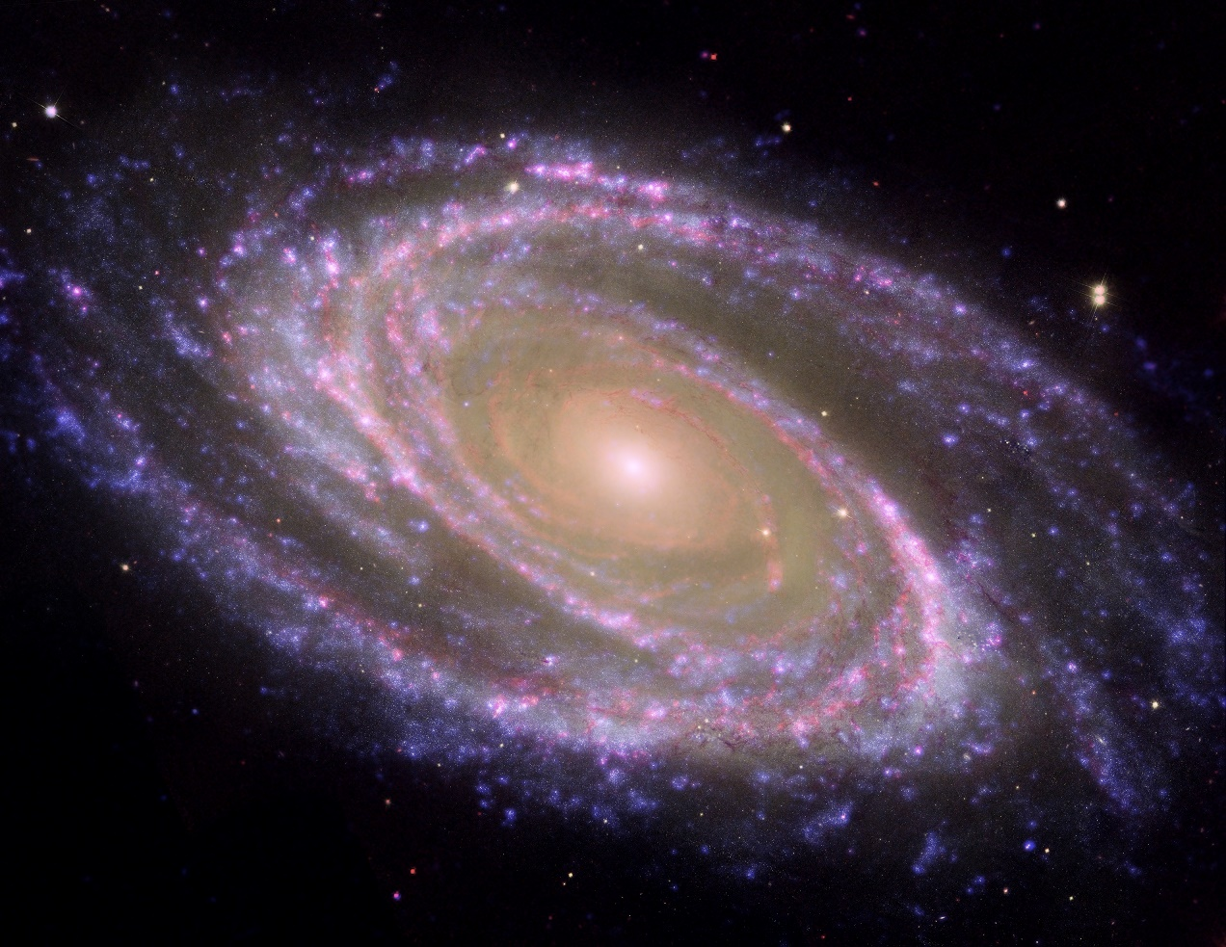
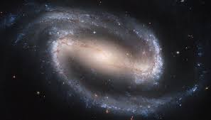
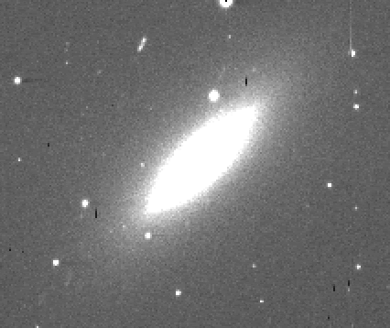
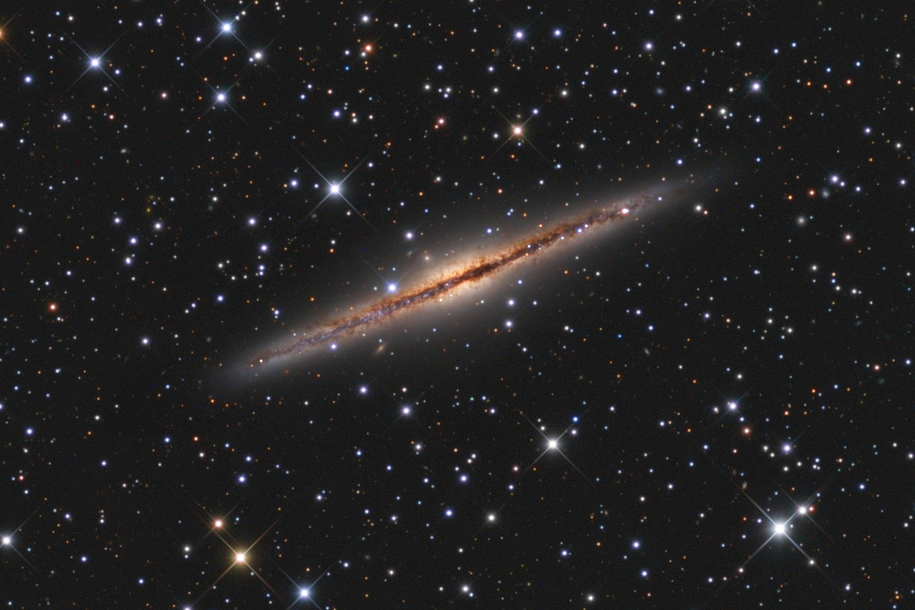
Training set: gz2
Six total questions, trained separately
Only included galaxies with:
more than 5 votes
Strong agreement among classifiers

Slide 9
Evaluating performance: gz2
Test set: 984 visually classified SDSS galaxies from Cheng et al. (2011)

Slide 10
Evaluating performance: gz2
Bar Feature

Slide 11
Evaluating performance: N10

Slide 12
Applying to more galaxies
Authors used trained CNN to classify 670,000 galaxies
Includes original set of 270,000 GZ2 galaxies for comparison
Large, high fidelity morphological catalog.

Slide 13
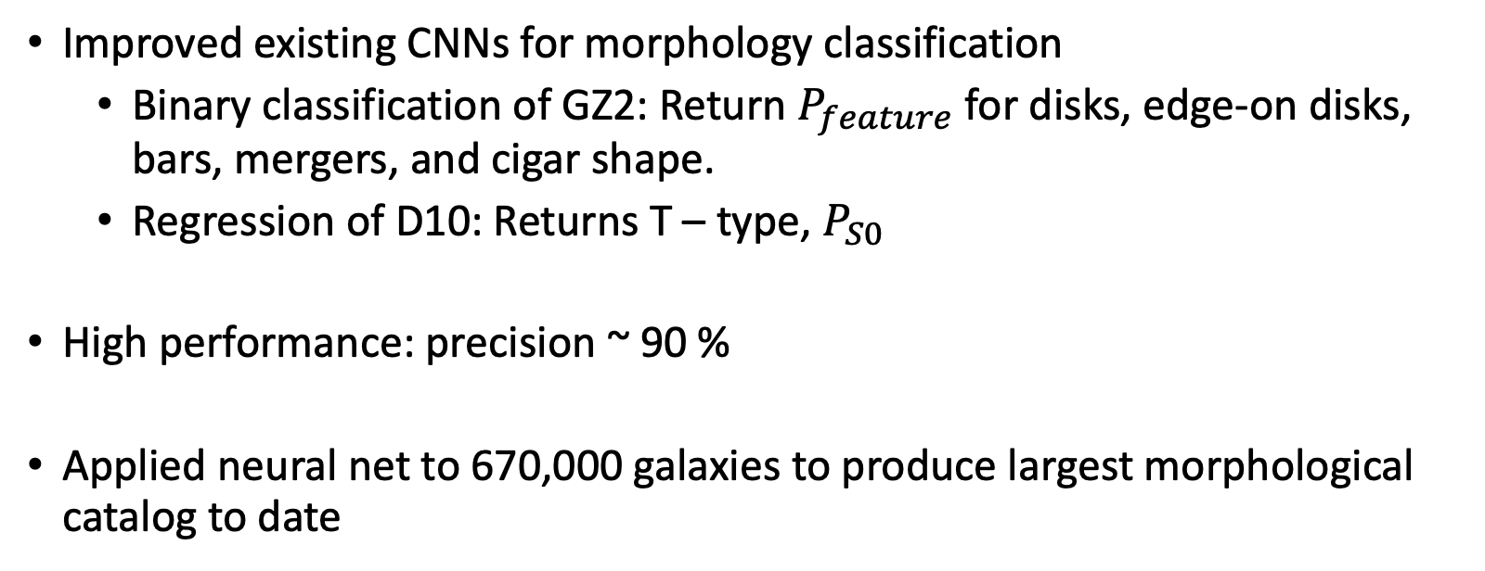
summary
Improved existing CNNs for morphology classification
Binary classification of GZ2: Return $P_{feature}$ for disks, edge-on disks, bars, mergers, and cigar shape.
Regression of D10: Returns T – type, $P_{S0}$
High performance: precision ~ 90 %
Applied neural net to 670,000 galaxies to produce largest morphological catalog to date

Slide 14
questions?
Thanks for listening!

Slide 15
Quantifying agreement: criteria for robust classification

Slide 16
Evaluating performance: gz2
Disk Feature

Slide 17
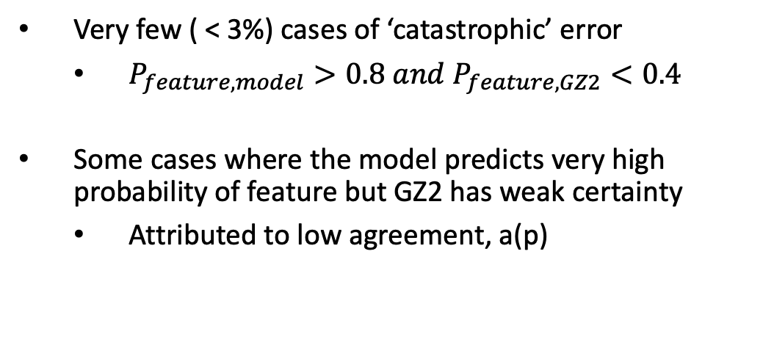
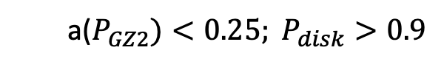
Disagreement?
Very few ( < 3%) cases of ‘catastrophic’ error
$P_{feature,model}>0.8 and P_{feature,GZ2}<0.4$
Some cases where the model predicts very high probability of feature but GZ2 has weak certainty
Attributed to low agreement, a(p)
a($P_{GZ2})<0.25; P_{disk}>0.9$

Slide 18

Evaluating performance: n10
Performance shaky at separating E and S0 as expected
Train a second model using weights of previous CNN T-type model,
Label input galaxies with -3 < T < 0 as positive examples; T = -5 as negative
Returns $P_{S0}$: Probability of being S0 opposed to elliptical.

